Slide 1
Electronic Commerce
Syed Asim Jalal
Department of Computer Science
University of Peshawar

Slide 2
Internet
Vs
Web (World Wide Web or www)

Slide 3
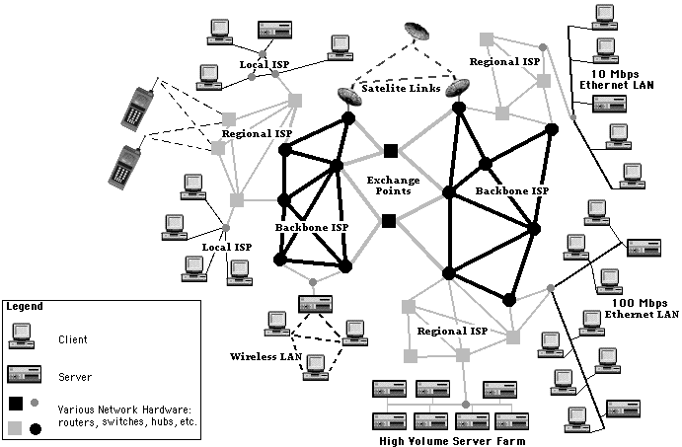
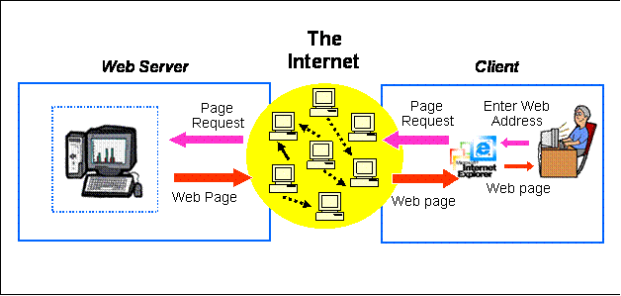
  Internet is the network of networks that connects computers worldwide.
  World Wide Web is the system that uses HTTP protocol to transfer information between computers over the internet.
    Information: webpages, text, multimedia etc

Slide 4
Internet - simply
‘internet’ – network of networks
The “Internet” is network of networks throughout the world
Computers in each network is able to communicate with other computers in other network for specific services.
Network applications bases on different protocols can run on the Internet
    Web (HTTP)
    Email (SMTP)
    File Transfer services (FTP)

Slide 5
The Web: World Wide Web or www
The Web is the system that uses HyperText Transport Protocol (HTTP) protocol to transfer information between computers.
    Information in the form of webpages
  Information transfer requires a client (web browser) and a server (web server) with information in the form of webpages.
The World Wide Web is the collection of server computers hosting webpages.

Slide 6
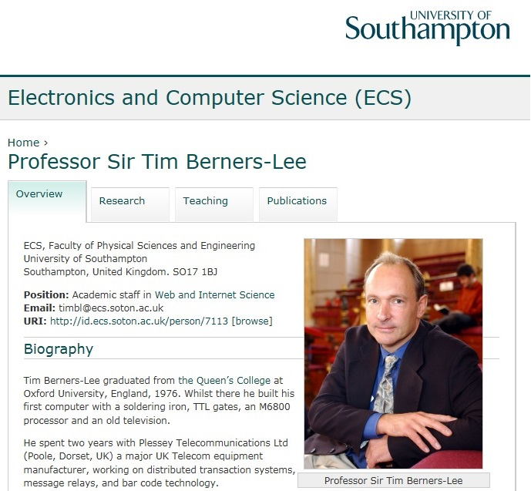
World Wide Web ( or www)
Tim Berners-Lee invented the World Wide Web in 1989.

Slide 7
Tim Berners-Lee invented the World Wide Web (www) while at CERN, the European Particle Physics Laboratory, in 1989.
He wrote the first web client (browser) and server in 1990 and specifications of URIs, HTTP and HTML.
    Info.cern.ch was the address of the world's first-ever web site
    The first web page address was http://info.cern.ch/hypertext/WWW/TheProject.html

Slide 8
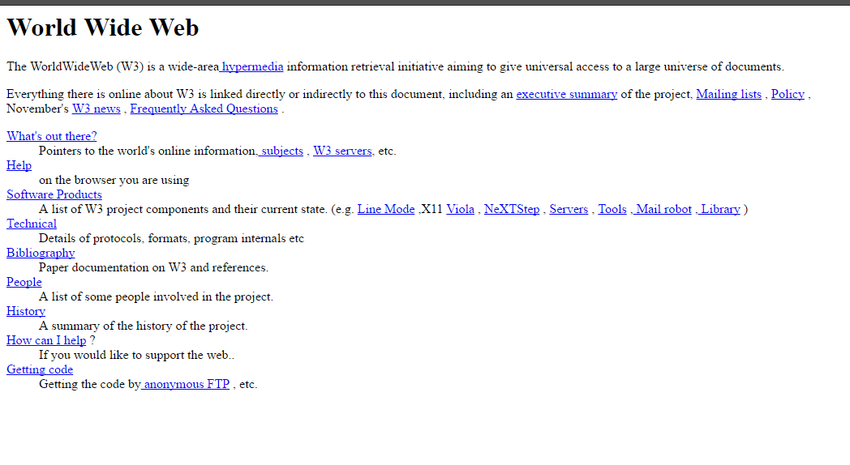
First ever webpage
http://info.cern.ch/hypertext/WWW/TheProject.html

Slide 9

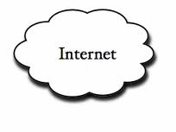


Web Architecture
Client request
Server response
Client running a Web Browser
HTML files
Server computer running Web Server Software ( e-g: IIS, Apache, etc.)

Slide 10
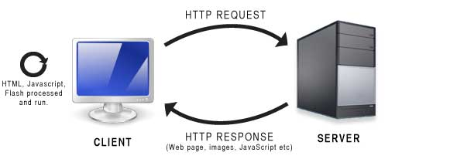
HTTP
Hypertext Transfer Protocol (HTTP)
HTTP is the protocol used by data transfer over World Wide Web.
  Web browsers and Web servers communicate through HTTP
HTTP is a request and response protocol

Slide 11
HTML
HyperText Markup Language for writing web documents or webpages
  Hypertext:
      Hypertext refers to a piece of text that acts as a link to another document.
  Markup Language:
      It provides a way of writing layout information for formatting contents of a web document, by putting commands or tags ( <tagName>) around text.
A webpage is an HTML document
    An HTML document is a file that contains text and tags around different texts that describe the structure, format and purpose for text or multimedia objects.

Slide 12
HTML is Interpreted language
HTML is an interpreted language
Web Browser acts as an interpreter for HTML
Interpreted language does not need compilation of the program, e-g: C or Java etc, (which need compilation)
In interpreted language the interpreter reads the program code and execute each command one by one.

Slide 13
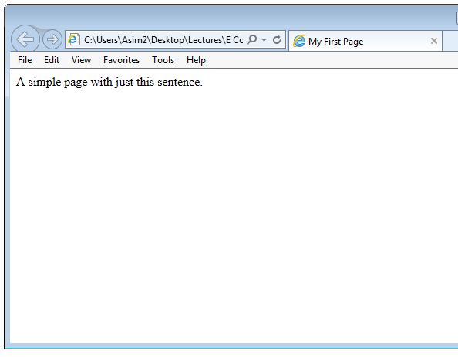
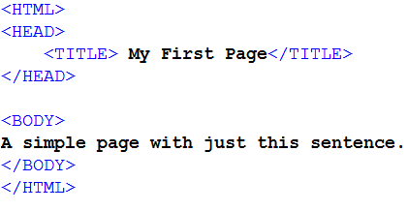
Tags in HTML
Tags looks like: <tagName>
When a browser opens an HTML file, the browser will look for HTML codes or tags in the text and apply them to format or structure the text, multimedia or create hyper links to other webpages.

Slide 14
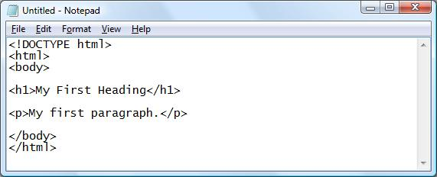
HTML editor – How do you write HTML Code?
HTML code can be written in simple text editor like notepad in windows
You need to save the HTML code document with extension .html extension or an .htm (for instance "mypage.html").

Slide 15
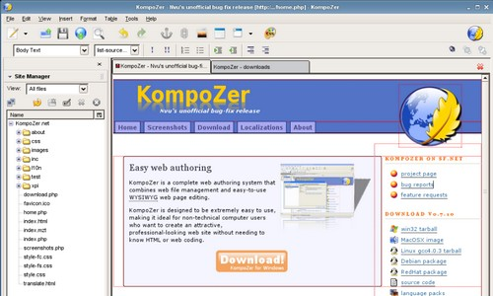
WYSIWYG editor
We can also use a WYSIWYG editor ("What You See Is What You Get").
  Examples of WYSIWYG Editors
  Microsoft FrontPage
  Macromedia Dreamweaver
  Microsoft Word
  etc

Slide 16
WHY LEARN HTML – these days?
It is possible to create webpages without understanding HTML.
Why learn HTML then??
  You need knowledge of HTML for server side programming.
  In server side programming you display data from databases in webpages.
  You write data retrieval server side programming code with in HTML and then display it using HTML in required HTML formatting.

Slide 17
HTML Structure
  Simple first example:
  Use any text editor
  Type the code above (copy html code sometimes creates problem)
  Save the file in using extension .htm or .html
  Open in any web browser.

Slide 18
  HEAD section
    Info about the document
    Info in header not generally rendered in display window
    TITLE element names your Web page
      Title visible on top of browser.
    It can include meta tags which contain the key words used by search engines.
      e.g: <meta name= "keywords" content= "…..">
  BODY section
    Contains page content
      Includes text, images, links, forms, etc.

Slide 19
Common HTML tags categories
Text formatting
  Bold, font type/size/color, alignment (center, right, left)
  Paragraph, headers,
Links
Displaying Multimedia (audio/video)
Creating Lists
  Ordered lists
  Unordered lists)
Creating Table
  Tables are used a lot for structuring webpages
Creating forms
  Forms are created in webpages to take input from users.
  Text fields, buttons, drop down lists etc.

Slide 20
Text formatting
Italics
  Emphasis (italics) style: <EM>text</EM>
  Older tag: Italics <i> and </i>
Bold
  Strong (bold) style: <STRONG>…</STRONG>
  Older tag: Bold <b> and </b>
Underlined
  <u> and </u>
All capital or BIG letters:
  <big> and </big>
All small letters:
  <small> and </small>

Slide 21
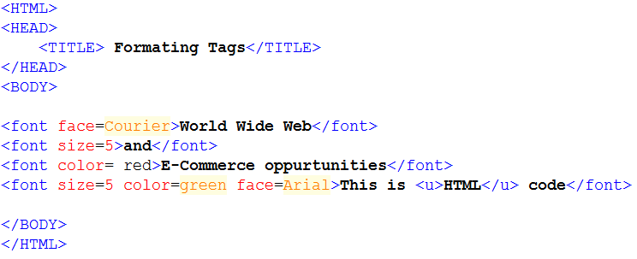
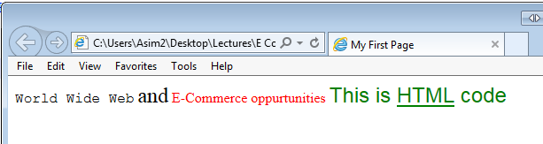
Font
Font face: <font face=“Arial”> texttext </font>
Font size from 1 to 7: <font size=5> texttext </font>
Font color: <font color= red> texttext </font>
Combined:
<font size=5 color=green face=Arial> texttext </font>

Slide 22
Line break
  <br>
  Enters a new line. Everything after this line will be displayed in new line.
  Horizontal line: <hr>
Tag for CENTER
  <center> text text text</center>
  This applies on everything between these two tags
  Images, tables, text, etc.

Slide 23
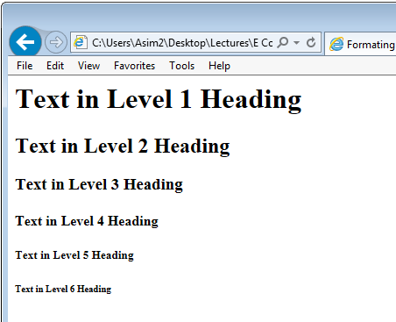
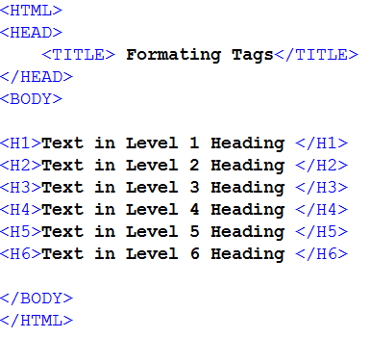
Heading
HTML provides 6 headings.
  <H1>, <H2>, … , <H6>

Slide 24
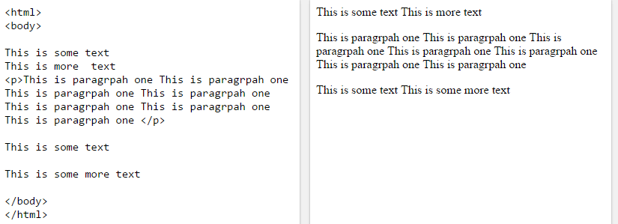
<p>
Paragraph: <p>
  Paragraph is started with new line and puts a new line at the end.
  <p> text text text </p>

Slide 25
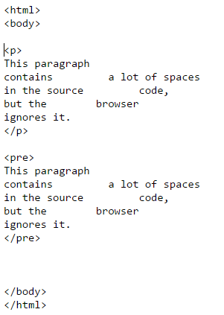
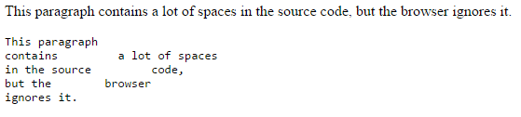
<pre> element defines preformatted text.

Slide 26
Text Alignment
  ALIGN = "center“
  ALIGN = "left “
  ALIGN = "right“
  Example:
  <p align=“center”> text text text </p>

Slide 27
1 <HTML>
2
3
4
5
6 <HEAD>
7 <TITLE>Internet and WWW How to Program - Welcome</TITLE>
8 </HEAD>
9
10 <BODY>
11 <H1 ALIGN = "center"><U>Welcome to Our Web Site!</U></H1>
12
13 <P>We have designed this site to teach
14 about the wonders of <EM>HTML</EM>. We have been using
15 <EM>HTML</EM> since <U>version<STRONG> 2.0</STRONG></U>,
16 and we enjoy the features that have been added recently. It
17 seems only a short time ago that we read our first <EM>HTML</EM>
18 book. Soon you will know about many of the great new features
19 of HTML 4.0.</P>
20
21 <H2 ALIGN = "center">Have Fun With the Site!</H2>
22
23 </BODY>
24 </HTML>

Slide 28
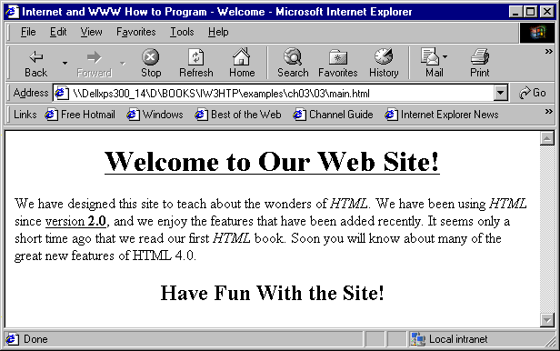

Slide 29
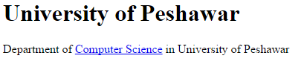
Links
<HTML>
<BODY>
<H1>University of Peshawar</H1>
Department of <A HREF=“http://www.dcs.edu.pk” >Computer Science </A> in University of Peshawar
</BODY>
<HTML>
Hypertext: Link to other pages
<a href= “http://www.linkAddress.com” > textLink </a>

